Slide 1

Case1:The development of nanosatellite architecture(GHalam)
Team: “Goodbye World”

Slide 2

objective
Compare two different 6U satellites with basic and more advanced-efficient design in terms of similar targets:

Slide 3
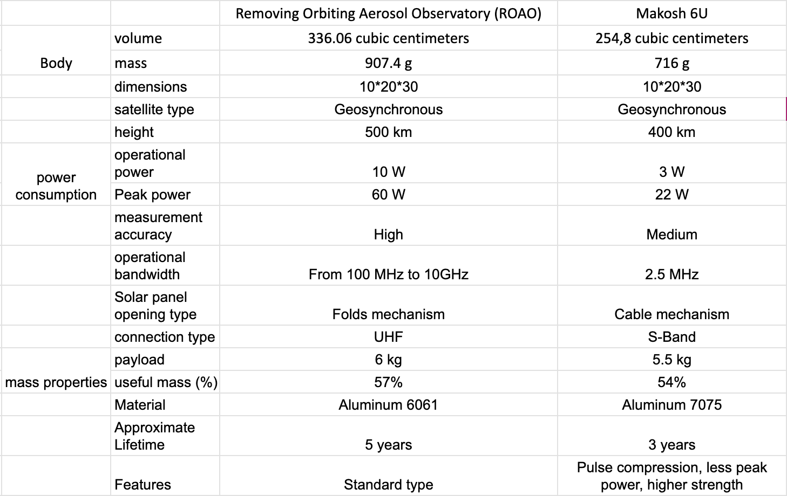
Table of comparison:

Slide 4
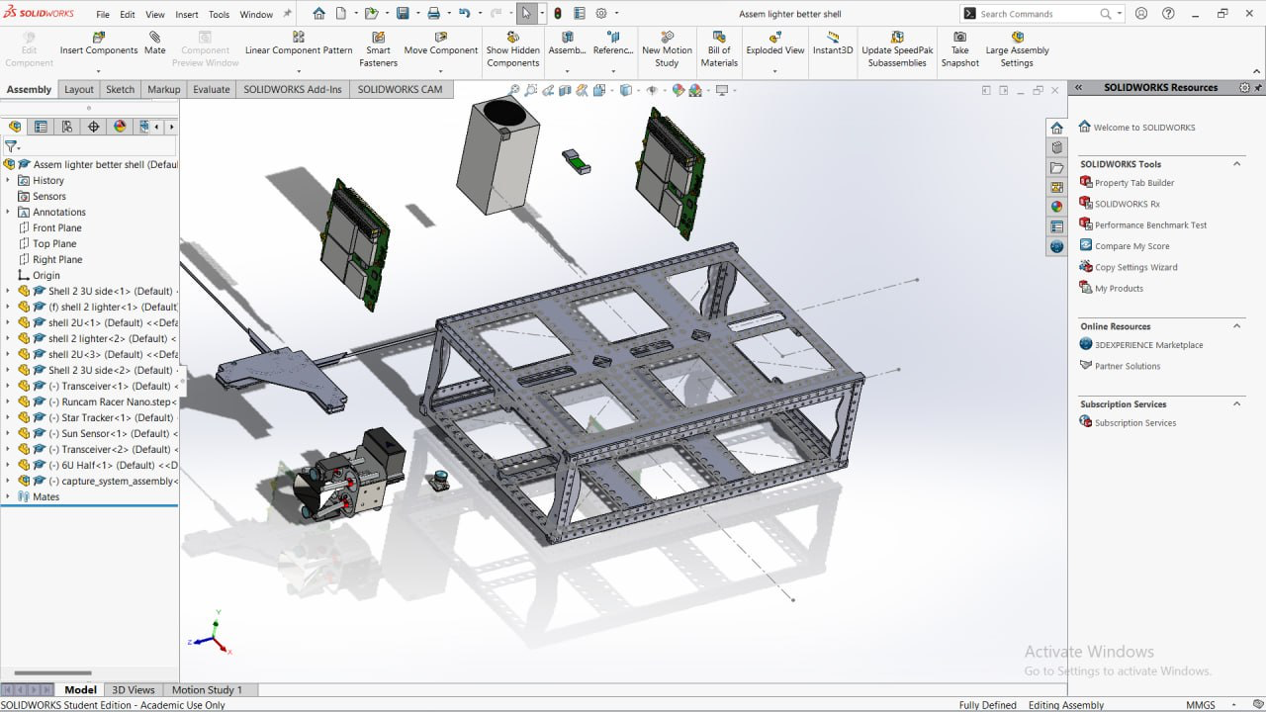
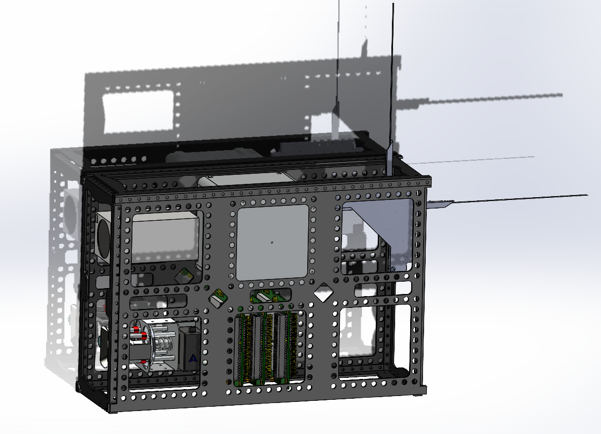
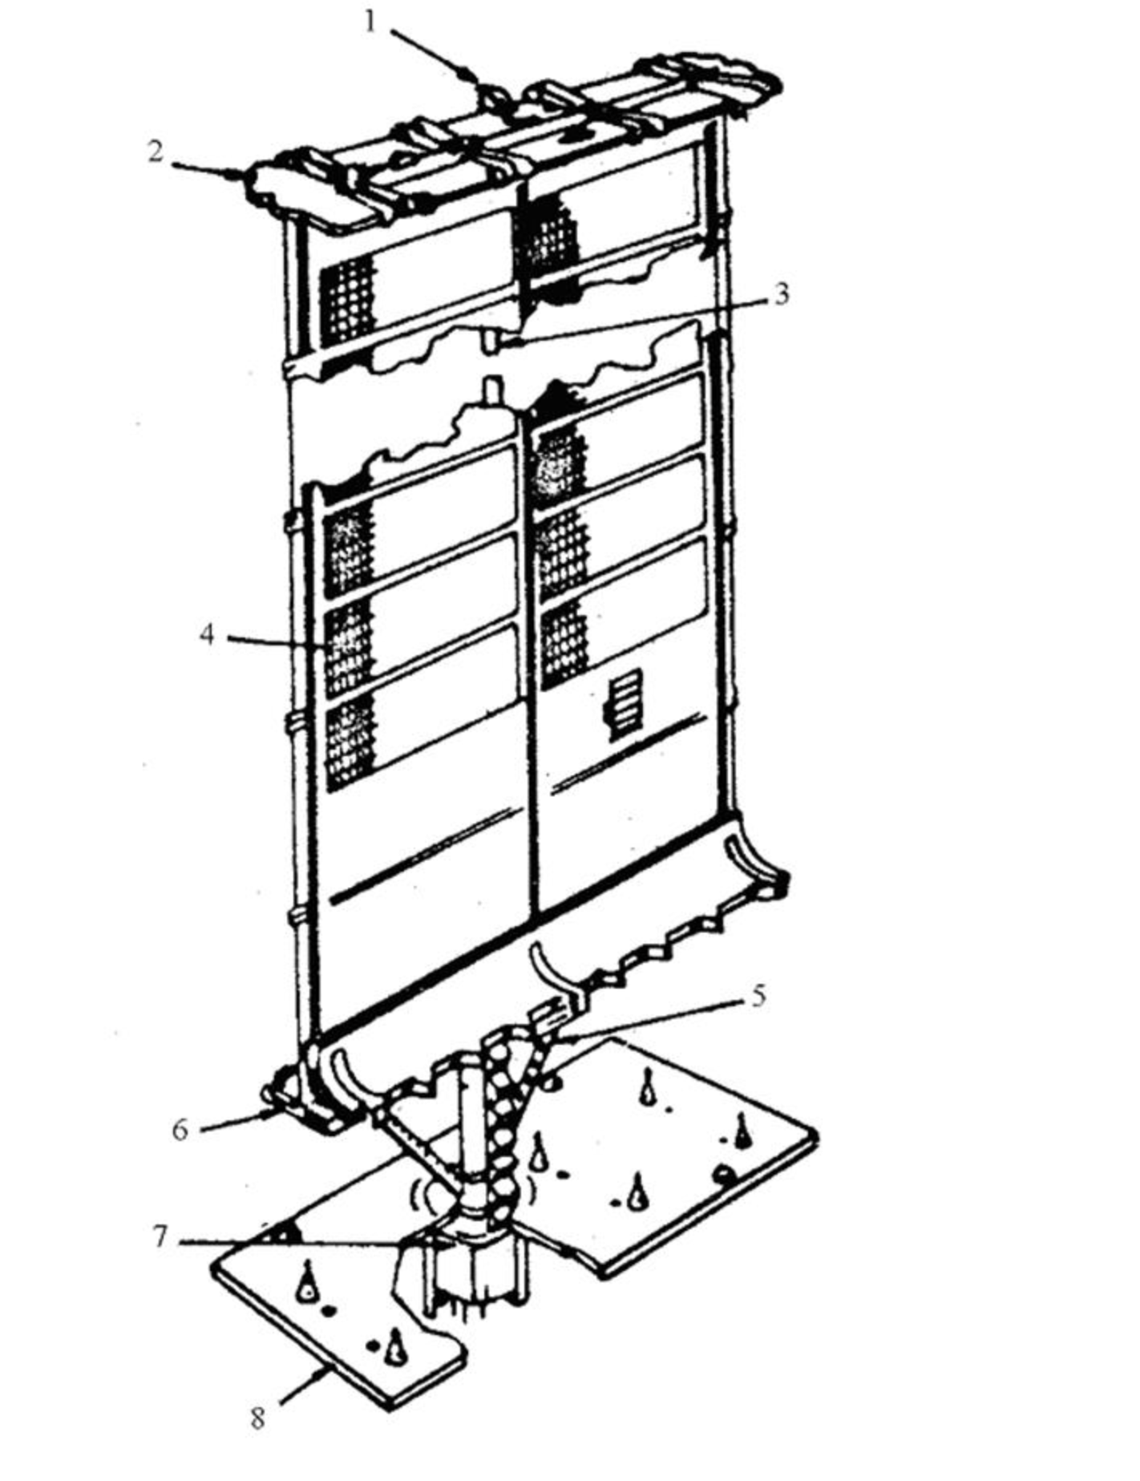
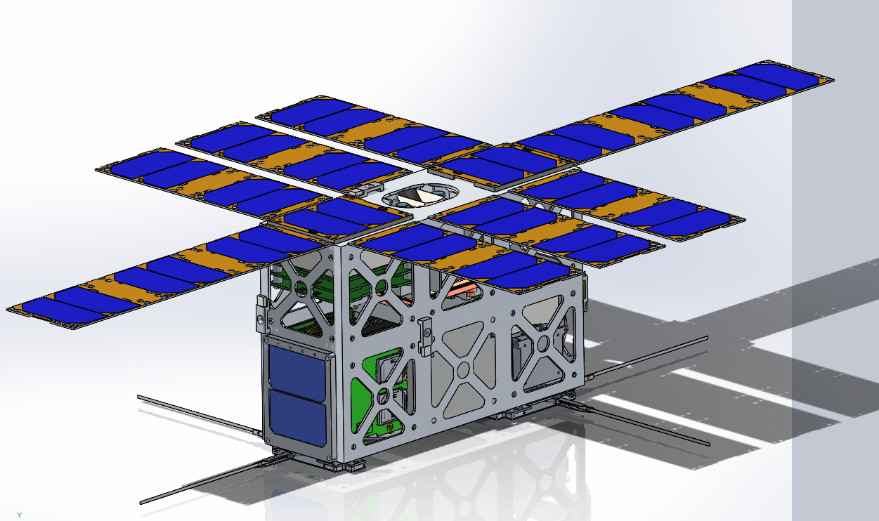
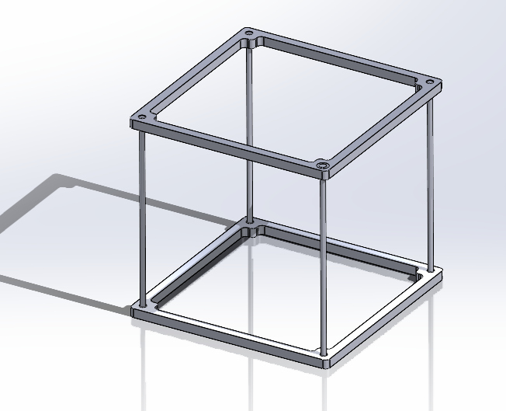
3D Models of two satellites:

Slide 5
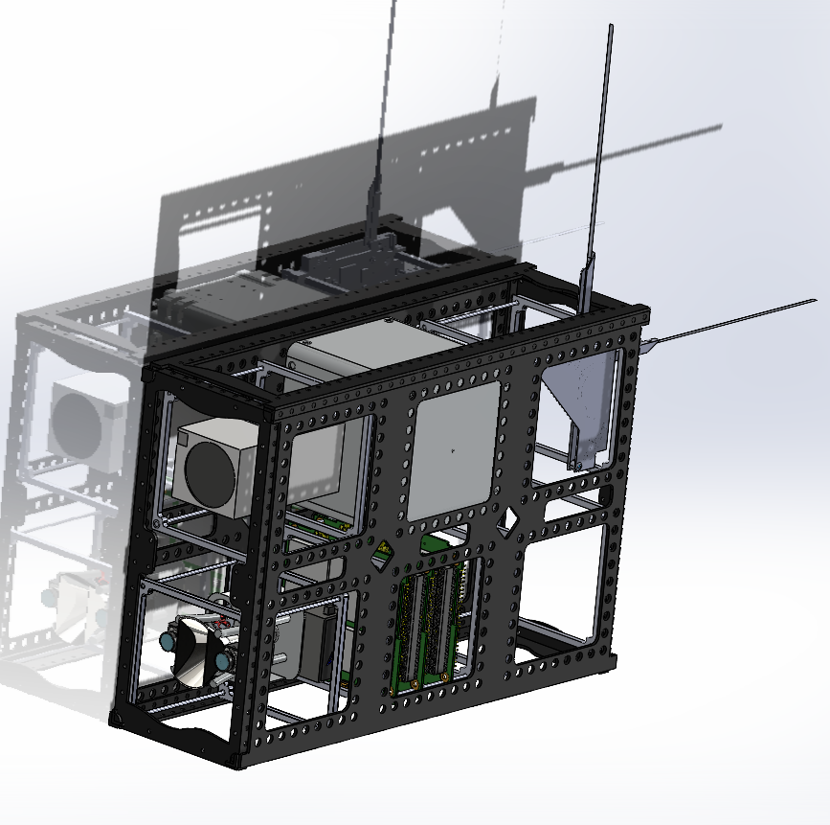
Model Overview (Makosh 6u)

Slide 6
Resource assesment
Cost of development Less than: 100,000 dollars
Launching cost: 15,000 dollars (through Roscosmos)
Time required for development - 18 months
Specialists required - Electrical, Computer, Mechanical, Materials Engineers
Materials: aluminum 7075 alloy, aluminum 6061 T6
Contain alloy agents such as magnesium, silicon, copper, iron, zinc, titanium, manganese and chromium.
6061 alloys provide superior welding abilities and workability over other alloys, it doesn’t boast the same high strength and stress resistance as 7075 offers.
7075 - high strength.
6061 - lower cost.

Slide 7
Justification of each design
The development of our second new satellite was based on the advanced featerues
through researching of different commercial satellites.

Slide 8
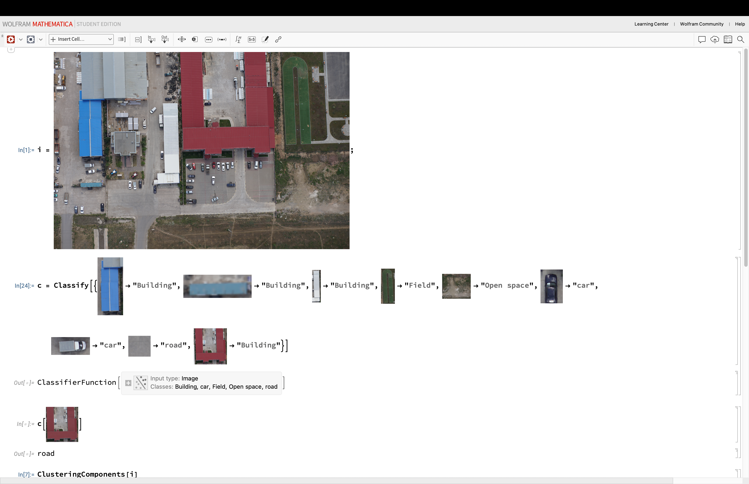
Additional ideas: Advanced Imaging concept:
The staellites can be used as
a tool for imaging:

